Slide 1
Tax-Aide Policy and Procedures Review
For Review with All Volunteers Tax Year 2016

Slide 2
Goal
Improve volunteer satisfaction and create a satisfying experience for taxpayers by reviewing IRS and Tax-Aide policies with all volunteers

Slide 3
Overall Objectives:
Ensure awareness of
IRS grant requirements
AARP Foundation Tax-Aide Standards of Professionalism
AARP Foundation Tax-Aide Program policies and procedures
Provide training for all volunteers
Volunteer Standards of Conduct (VSC)
Quality Site Requirements (QSR)
Program policies and procedures

Slide 4
Policies and Procedures
IRS
AARP Foundation Tax-Aide Program
Standards of Professionalism
Volunteer Standards of Conduct
Taxpayer Information and Responsibilities
Quality Site Requirements
Incident Review Protocol
Notes:
IRS requires training on their two topics as part of grant requirements to fund Tax-Aide program

Slide 5
Key Resource: Client Service Provider Digest
Additional important information provided in the Client Service Provider Digest:
Counselor Guidelines and Policies
Conflict of Interest Guidelines
Confidentiality and Security of Taxpayer Data
Liability Protection
AARP Foundation Volunteer Standards of Professionalism
Activity Reporting
Notes:
The Client Service Provider Digest provides a lot of good information for volunteers and the checked items should be reviewed in detail. Suggest having volunteers open the Client Service Provider Digest and briefly review items.
Client Service Provider Digest can be viewed electronically on OneSupport, or Instructors can order sufficient copies for all volunteers to have a printed copy. The stock number is D16276. Allow 2 weeks to order printed copies.

Slide 6
IRS Volunteer Standards of Conduct
To establish the greatest degree of public trust, volunteers are required to maintain the highest standards of ethical conduct and provide quality service.
Each volunteer agrees to the terms of the Volunteer Standards of Conduct when he/she signs the Volunteer Agreement (Form 13615) – the ‘contract’ between the IRS and each volunteer.
Notes:
The Standards of Conduct are listed on Form 13615 Volunteer Standards of Conduct Agreement – VITA/TCE Programs. This is the document that all volunteers (preparers, Quality Reviewers, greeters, Client Facilitators, etc.) have to sign.

Slide 7
IRS Volunteer Standards of Conduct
Follow the Quality Site Requirements
Do Not accept payment or solicit donations for federal or state tax return preparation
Never solicit business for self or others
Do Not knowingly prepare a false return
Do Not engage in any criminal or any conduct deemed to have a negative effect on the program
Treat all taxpayers in a professional, courteous and respectful manner
Notes:
The Standards of Conduct are listed on Form 13615 Volunteer Standards of Conduct Agreement – VITA/TCE Programs. This is the document that all volunteers (preparers, Quality Reviewers, greeters, Client Facilitators, etc.) have to sign.

Slide 8
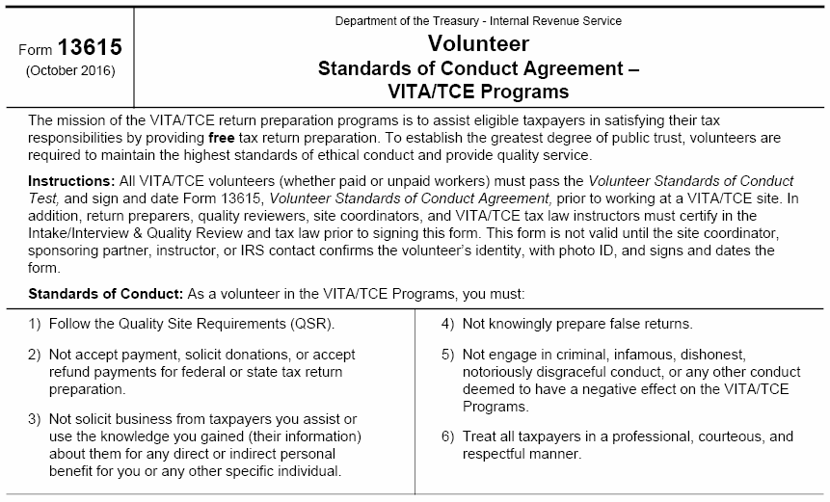
Volunteer Standards of Conduct All volunteers must sign Form 13615
critical text
Instructions: All VITA/TCE volunteers (whether paid or unpaid workers) must pass the Volunteer Standards of Conduct Test, and sign and date Form 13615, Volunteer Standards of Conduct Agreement, prior to working at a VITA/TCE site. In addition, return preparers, quality reviewers, site coordinators, and VITA/TCE tax law instructors must certify in the Intake/Interview & Quality Review and tax law prior to signing this form. This form is not valid until the site coordinator, sponsoring partner, instructor, or IRS contact confirms the volunteer’s identity, with photo ID, and signs and dates the form.
Notes:
The Standards of Conduct are listed on Form 13615 Volunteer Standards of Conduct Agreement – VITA/TCE Programs. This is the document that all volunteers (preparers, Quality Reviewers, greeters, Client Facilitators, etc.) have to sign.

Slide 9
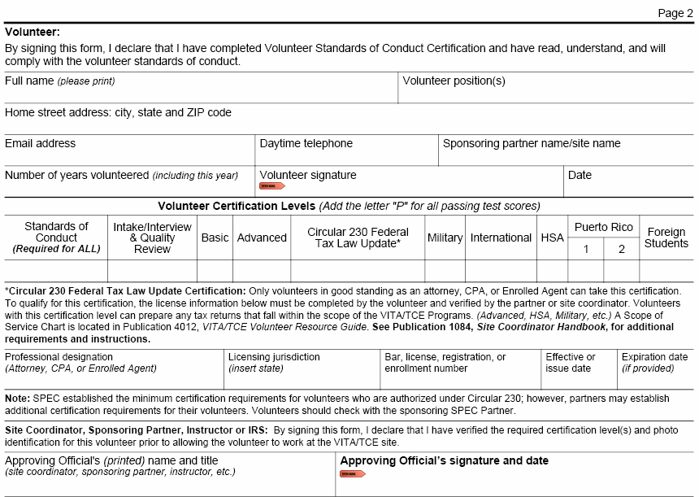
Form 13615, Page 2
Electronic OK
N/A
Must be Handwritten
Notes:
Note that this form is also used to request that the IRS grant Continuing Education credits to volunteers who are CPAs or paid tax preparers. The bottom portion of the form should be completed by the volunteer and given to his/her supervisor to review and approve. Credit can be requested for 1) providing Quality Review at a tax site 2) providing instruction in specified tax topics or 3) preparing returns at tax sites. Once approved by the volunteer’s supervisor, the supervisor or designated leader on the local level should forward completed forms to the designated local SPEC relationship manager. Requests for CE credit for being an Instructor/Trainer can be done after the training is complete, however requests for either return preparation and/or Quality Review should be sent no earlier than April 30. Reminder only 10 volunteer hours are required to receive the maximum level of CEs, so do not wait to the end of the season to submit.

Slide 10
Standards of Professionalism
The AARP Foundation Tax-Aide standards for each volunteer
Do Not discuss politics, race, nationality, gender identity or religion
Treat all taxpayers/volunteers equally and with courtesy – no discrimination
Only prepare in-scope returns
Notes:
Volunteers may refer to the Taxpayer Information and Responsibilities poster which highlights Tax-Aide’s expectations of taxpayers and volunteers.

Slide 11
Standards of Professionalism
Ensure all tax returns receive a Quality Review by 2nd certified Counselor
Do not discuss taxpayer information with anyone who does not have a “need to know”

Slide 12
Standards of Professionalism
When issue arises regarding taxpayer return that requires consultation with 2nd volunteer:
Discuss away from taxpayer
Discuss quietly to ensure other taxpayers do not hear private information
Resolve differences of opinion privately to sustain taxpayer confidence in the knowledge and skills of the Counselors

Slide 13
Standards of Professionalism
Provide assistance to those with disabilities
Assure welcome
Notify Local Coordinator if requested assistance is not available
Upset taxpayer?
Attempt to diffuse situation
Move to quiet area, if possible
Immediately notify Local Coordinator

Slide 14
Standards of Professionalism
Do not provide any volunteer’s personal information (other than first name) to anyone
Refer inquiries to Local Coordinator
Notes:
First name basis only – no last names

Slide 15
IRS Quality Site Requirements
Purpose of Quality Site Requirements (QSR) is to ensure quality and accuracy of tax return preparation and consistent operation of sites
Volunteers agree to adhere to ten QSRs in Standards of Conduct #1

Slide 16
Summary of IRS Quality Site Requirements (QSR)
 |  | Who is responsible?
1 | Volunteer certification | LC/Instructor
2 | Intake and Interview and Quality Review Process | Counselor/QR
3 | Photo Identification and Taxpayer Identification Numbers | Counselor/QR
4 | Reference Material | LC
5 | Signed Volunteer Agreement | All
Notes:
Let Counselors and Client Facilitators know that they are responsible for compliance only on the requirements marked in blue, however they should be aware of the other requirements to assist leaders to bring sites into compliance with all requirements. Advise that when IRS does a site review the site will receive a “grade” on each of the requirements; QSR requirements are also reviewed when Tax-Aide leaders do an internal site review.
Client Facilitators or “Greeters” are required to take the Intake/Interview and Quality Review Test so that they are familiar with the Quality Review process and be able to explain the process to a taxpayer.

Slide 17
Quality Site Requirements
 |  | Who is responsible?
6 | Timely Filing of Tax Returns | LC/ERO
7 | Civil Rights Requirements | LC
8 | Correct Site ID number (SIDN) | LC/ERO
9 | Correct Electronic Filing Identification Number (EFIN) | LC/ERO
10 | Security | All

Slide 18
What You Need to Know
QSR #1
Volunteer Certification
All volunteers sign Form 13615 agreeing to adhere to the VSC
ADS oversees the Tax-Aide volunteer certification process and ensures that volunteers’ certifications are submitted to Tax-Aide National Office and NVP updated
All out-of-scope tax returns are referred to a professional tax return preparer
All volunteers must complete training and pass tests appropriate for their role(s)
Notes:
QSR – Quality Site Requirement
VSC – Volunteer Standards of Conduct

Slide 19
Required Training
All
Volunteer Site Policies and Procedures Training (includes Tax-Aide Standards of Professionalism)
Client Facilitator, Local Coordinator and Shift Coordinator
Intake/Interview and Quality Review Training
Client Facilitator – Client Facilitator training
Local Coordinator – Local Coordinator training
Others based on role(s)
Notes:
Updated Policy and Procedures Manual in September. New this tax season, Client Facilitators must complete the Intake/Interview Quality Review training and test. This can be either a classroom, in-person training, webinar or by using Link & Learn.

Slide 20
Required Tests
All – Volunteer Standards of Conduct Test
Client Facilitator, Local Coordinator and Shift Coordinator – Intake/Interview and QR Test
Counselor, Instructor, TRC, TRS and ERO – 1. and 2. plus Advanced Test
Notes:
Updated Policy and Procedures Manual in September. New this tax season, Client Facilitators must pass the Intake/Interview Quality Review test. This can be accomplished through Link & Learn or by paper, although it is recommended that volunteers use Link & Learn.

Slide 21
What Volunteers Need to Know
QSR #2
Intake/Interview
Must use current year Form 13614-C – Interview/Intake & Quality Review Sheet for every taxpayer
Ask probing questions to ensure accurate and complete answers
Note new or changed information on form
100% use of form with sufficient interview of taxpayer to ensure accuracy and completeness of return
Notes:
Intake form must be completed even for taxpayers who are unlikely to experience any change from year to year, or those who say that nothing has changed. If the taxpayer has difficulty completing the form, the Client Facilitator can assist by reading the questions and/or providing explanation, however a non-certified Client Facilitator can’t provide tax law information.
Volunteer may not ignore information furnished to, or actually known by, the preparer
Preparer needs to ask questions if the information furnished appears to be incorrect, inconsistent, or incomplete
The form documents what happened at the tax site, and assists taxpayers to remember what they told the Counselor. In the event that there is a subsequent disagreement as to what a taxpayer told the Counselor, the intake form serves as the printed record of the conversation for the taxpayer and/or family members.
When a taxpayer later asserts that their return was done incorrectly by a Counselor, the intake form provides critical information as to the discussion between the Counselor and taxpayer.
Counselors should document “changed answers” to critical questions on the intake form to indicate that the return was changed due to additional information provided by taxpayer. This also assist the Quality Reviewer to know what questions were asked and what information was provided by the taxpayer.

Slide 22
What Volunteers Need to Know
QR must be with taxpayer
Full review and discussion of all pages of Intake Sheet
QR must include probing questions to ensure correct application of tax law, not just verification of name and numbers
Note new or changed information on form
QSR #2 (cont)
Quality Review Process
100% Quality Review by 2nd Counselor
Notes:
See “Gold Standards for Quality Review” document on OneSupport for full details as to how to conduct a quality review.
QR should pay close attention to see that 1) all forms that the taxpayer brings to the site are appropriately entered onto the return and 2) that all information marked on the intake form is correctly documented on return. For example, Interest income could be missed if the taxpayer fails to bring the form but notes on the intake form that they have interest income.
While it is important to maintain an effective flow of taxpayers at a site, it is never appropriate to fail to do a complete Quality Review because it takes too long, or because other taxpayers are getting impatient. Remind waiting taxpayers that when their turn comes that you will be just as thorough in preparing and reviewing their return.

Slide 23
What Volunteers Need to Know
QSR #3
Photo Identification and Taxpayer Identification Numbers
All taxpayers show photo ID*
SS cards or ITIN documents for all people on return*
*rare exceptions approved by LC
Process is in place to confirm taxpayer identities and identification numbers
Notes:
Exception if taxpayer personally known to Counselor
May accept last year’s tax return plus this year’s tax documents if all match in lieu of TIN documents

Slide 24
What Volunteers Need to Know
QSR #4
Reference Material
IRS Pubs 17 and 4012
Appropriate State Tax Instructions
IRS Intake/Interview and Quality Review Sheet (Form 13614-C) for every return prepared
Tax-Aide Cybertax Alerts
Have required IRS material available (paper or electronic)
Notes:
Process to ensure all volunteers have read CyberTax Alerts

Slide 25
What Volunteers Need to Know
QSR #5
Volunteer Agreement
Must pass Volunteer Standards of Conduct test and Intake/Interview and Quality Review test
Agree to comply with IRS Standards of Conduct
Agree to abide by program’s Standards of Professionalism
Volunteer Agreement must be signed by Volunteer and Instructor or Local Coordinator
100% volunteers sign Volunteer Agreement Form and understand Standards of Conduct
Notes:
Have copies of the AARP Foundation “Tax-Aide Standards of Professionalism” (on OneSupport) available for all volunteers to review. Advise that violations of either the IRS Standards of Conduct or the Standards of Professionalism will result in an Incident Review, and could result in termination from the program. Slides 17-20 provide more details
Signed originals of Volunteer Agreements are to be retained by District Coordinator or designee

Slide 26
What Volunteers Need to Know
QSR #6
Timely Filing of Tax Returns
Both taxpayer and spouse must sign Form 8879 to authorize e-file of return —Counselors may never sign for a taxpayer
All Counselors must inform taxpayer that he/she is responsible for accuracy of return before signing 8879
Any rejects must be resolved in timely manner (usually within 24 hours)
All taxpayers are reminded that the accuracy of the return is their responsibility
All returns filed in timely manner
Notes:
Remind taxpayer of their responsibilities by emphasizing key words from Form 8879 statement as you request they sign the document. Confirm with the taxpayer that he/she agrees that the return is:
true, correct, complete, OK to file

Slide 27
What Volunteers Need to Know
QSR #7
Civil Rights Requirements
AARP Poster (D143)
* Trash or re-cycle old posters!
Must display at “first point of contact between volunteer and taxpayer”
Sites must provide information to taxpayers regarding their Civil Rights

Slide 28
What Volunteers Need to Know
QSR #8 All Returns must have the correct Site Identification Number
TaxSlayer defaults set to ensure the correct SIDN automatically appears on each tax return
TaxSlayer defaults set to ensure the correct EFIN automatically appears on Form 8879
QSR #9 All Sites must have the correct Electronic Filing Identification Number
Notes:
Counselors should talk to the LC at their site to ensure that the process has been set up with the correct information for their site. Volunteers who work several sites should not change information for a site without consulting with the LC

Slide 29
What Volunteers Need to Know
QSR #10
Security, Privacy, Confidentiality
No taxpayer forms or information retained by volunteers
All returns prepared at site
Promptly report any lost data to National office
Volunteers wear name identification badge
No loss of taxpayer data

Slide 30
What Volunteers Need to Know
QSR #10 (cont)
Security, Privacy, Confidentiality
Know and comply with password requirements
Never post password on or near computer
Lock computer if you step away; turn screen so can’t be seen by someone other than taxpayer
Restrict cell phone usage; prevent photos of financial data
Don’t talk about a taxpayer’s return where others can hear
All taxpayer financial data is secure
Notes:
Password guidelines:
Minimum of 8 characters
Must contain alpha and numeric and at least one special character (this is a new requirement).
This change will be reflected in the production software in November 2016.
Choose a password that is not a dictionary word or someone’s name.
Do not use TaxSlayer, TS, Tax-Aide, AARP or any word in the password similar to something that is obviously related to the program

Slide 31
Security of Taxpayer Information
During follow-up conversation with taxpayer on rejected return
Tax-Aide volunteer should clearly identify himself/ herself including when and where return was prepared
Volunteer should obtain information such as birth date, details of an income document, etc. to verify that person is actual taxpayer
Do not include any taxpayer personal information (other than name) in an email
Notes:
Provide taxpayer assurance that you are Tax-Aide volunteer
Ensure you are talking to taxpayer

Slide 32
Security of Taxpayer Information
Do not retain any taxpayer data at any time other than for Form 8453
Do not exchange taxpayer data with anyone by email, by fax, by mail or by courier
Notes:
No retention of taxpayer data – not a signed Form 8879 just in case, no copies of W-2s, NOTHING – not even for an hour or a day or a couple of days!

Slide 33
Secure Equipment and Tax Data
AARP Foundation Tax-Aide approved anti-virus software must be installed and running on computers
AARP Foundation Tax-Aide approved firewall software program installed
Passwords required to control access to taxpayer data
Notes:
The Local Coordinator works with the Technology coordinator to assure that all equipment and software is secure. If Counselors see something on their computer that seems unusual or concerning, report it to the LC.

Slide 34
Loss of Equipment/Financial Data
Store equipment in secure limited-access environment when not in use
Immediately notify your volunteer leader if:
Computer is stolen or lost
Forms with taxpayer data are stolen, lost or a taxpayer has unauthorized access to another taxpayer’s documents
Volunteer leader must immediately call police to report loss of computer and number on back of volunteer badge
Incident Review must be completed and sent to volunteer supervisor and National Office
Notes:
See documents on One Support that explain when and how to file an Incident Review.

Slide 35
Summary: All Volunteers Must
Complete Volunteer Site Policies and Procedures Training
Pass the IRS Volunteer Standards of Conduct and Intake/Interview and Quality Review tests
Wear name tag with first name and first initial only of last name

Slide 36
Summary: All Counselors Must
Pass IRS Intake/Interview and Quality Review and Advanced tests
NOT prepare returns that are “out of scope” for Tax-Aide
NOT prepare a return for which they are not trained or do not have sufficient knowledge to prepare, even if it is “in-scope” (refer to another Counselor)
NOT prepare a return if they believe that the taxpayer is not truthful about the information provided
Notes:
The previous slide applied to all volunteers. This chart applies to Counselors i.e. tax preparers.
For more information on what tax topics and forms are In-scope and Out of Scope for Tax-Aide, refer to the Scope Manual, found on the OneSupport. Volunteers who prepare a return that contains tax topics and/or forms that are out of scope are NOT covered by the Volunteer Protection Act, and may be terminated from the program for failure to follow Tax-Aide policy.
Volunteers are permitted to use TaxWise software to prepare their own tax returns, and those of close family members, even if they contain topics and/or forms that are out of scope.

Slide 37
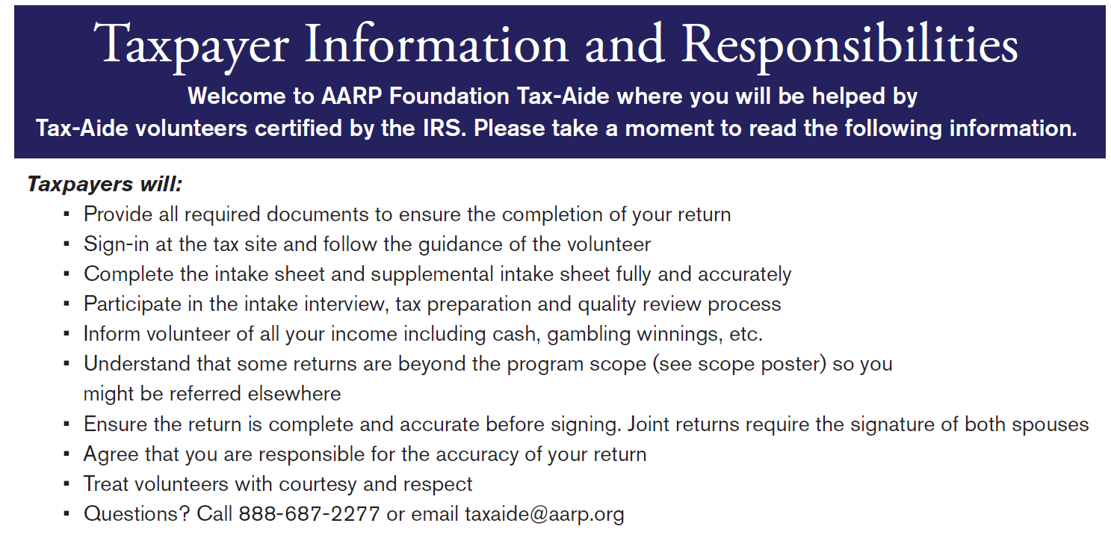
Taxpayer Information and Responsibilities
Available at site for taxpayers to review
Notes:
Taxpayer Information and Responsibilities tool highlights the expectations of the taxpayers as well as Tax-Aide’s pledge to the taxpayer.
There are four sections to the Taxpayer Information and Responsibilities tool
Section 1 - Guidelines for taxpayers
Section 2 – Guidelines for volunteers
Section 3 - Simplified overview of the Tax-Aide process, which the CF should explain to the taxpayer
Section 4 – A short list of essential documents taxpayers might need to bring to the site, depending on their circumstances
This slide covers the first section

Slide 38
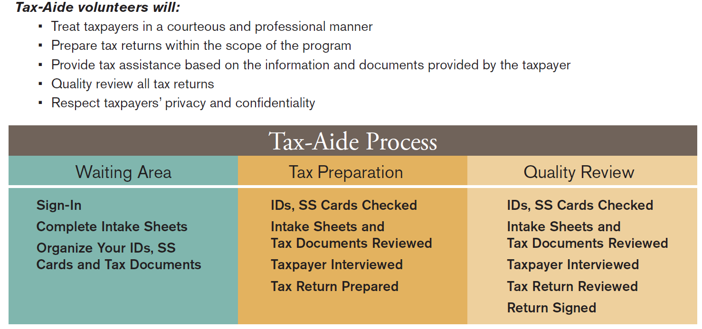
Taxpayer Information and Responsibilities (cont)
Notes:
This slide covers sections 2 and 3.
Section 2 includes guidelines for the volunteers to follow. If you experience working with a difficult taxpayer, please see the Local Coordinator or Shift Coordinator for assistance.
Section 3 is an overview of the process that the taxpayer will go through when receiving tax preparation assistance from Tax-Aide

Slide 39
Incident Review Protocol
Applies to events that relate to accidents, severe illness or threatening behavior
On OneSupport
Incident Review Instructions
AARP Foundation Tax-Aide Incident Review Form

Slide 40
Reporting Incidents
An Incident report is required if a volunteer is:
Injured at site or while on program business
Arrested, charged with or convicted of a crime
Alleged to have sexually harassed a volunteer or taxpayer
Alleged to be overly aggressive
Engaged in inappropriate fiscal (business) conduct
Violates Standards of Professionalism

Slide 41
Reporting Incidents (cont)
A volunteer or taxpayer:
Causes property damage at site
Becomes ill at site and 911 called
Indicate they plan to contact a lawyer or the media or AARP regarding an issue
Accident involving a taxpayer occurs at site
Taxpayer is asked to leave site and/or police are called

Slide 42
Closing for the Season
Ensure no taxpayer data remaining on site-owned, personal, IRS and Tax-Aide computers
Scanned files
Print spoolers
See OneSupport for details

Slide 43
Final Reminders: Volunteer Checklist
Secure Equipment and Tax Data
Certify: Pass Intake/Interview & QR test and Advanced test if a Counselor; Pass Intake/Interview & QR test if a Client Facilitator; IRS Standards of Conduct Test (all volunteers)
Follow key policies, e.g. IRS Standards of Conduct, AARP Foundation Standards of Professionalism
Interview/Intake process for every taxpayer
100% Quality Review by 2nd Counselor
Close for the day; have and comply with a process for tracking all e-files through acceptance – get returns to ERO
Close for the season properly
Accurately Report Service Activity – Include Q & As!

Slide 44
Volunteer/Site Policies and Procedures
Questions?
Comments…

